Slide 1
A Structural Theory of the Willingness-to-Pay Gap: Valuation and Behaviour in Climate Mitigation
Chris Ni

Slide 2
Part I: Research Question

Slide 3
Research Question: If people value climate change highly in a survey, why are they under-contributing?
Environmental economics often compares stated WTP and actual contribution as if they were two measurements of the same underlying WTP.
We claim that they are not necessarily the same object
We compare two coexisting frameworks under the same preference structure:
WTP as Compensating Variation (Valuation Model)
WTP as Optimisation Behaviour (Choice Model)
We show that a wedge arises generically.

Slide 4
Part II: Model Construction

Slide 5
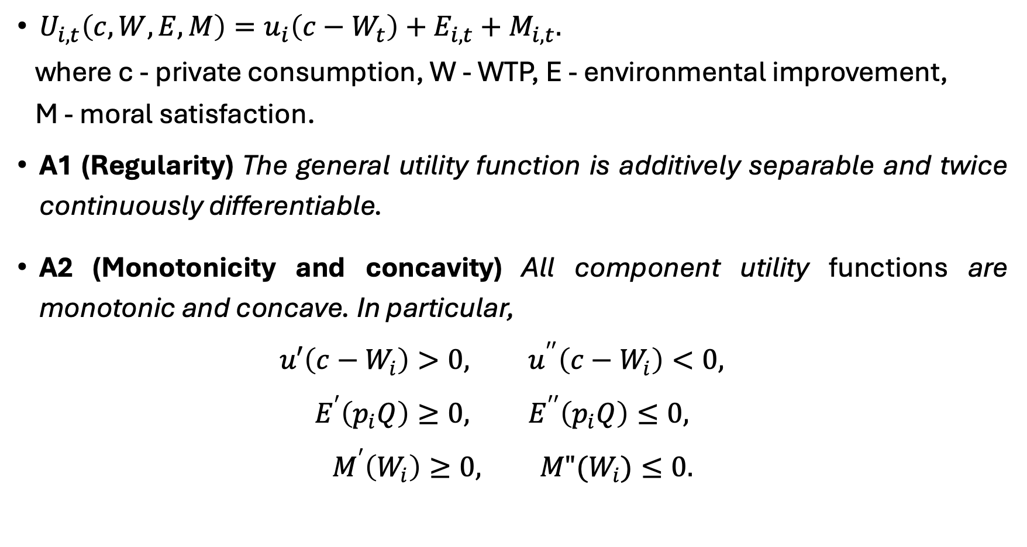
Primitives and Assumptions
$U_{i, t}\left(c,W, E, M\right)=u_{i}\left(c−W_{t}\right)+E_{i,t}+M_{i,t}.$
where c - private consumption, W - WTP, E - environmental improvement,
M - moral satisfaction.
A1 (Regularity) The general utility function is additively separable and twice continuously differentiable.
A2 (Monotonicity and concavity) All component utility functions are monotonic and concave. In particular,
$$u′\left(c−W_{i}\right)>0, u^{′′}\left(c−W_{i}\right)<0,$$
$$E^{′}\left(p_{i}Q\right)≥0, E^{′′}\left(p_{i}Q\right)≤0,$$
$$M^{′}\left(W_{i}\right)≥0, M"(W_{i})≤0.$$

Slide 6
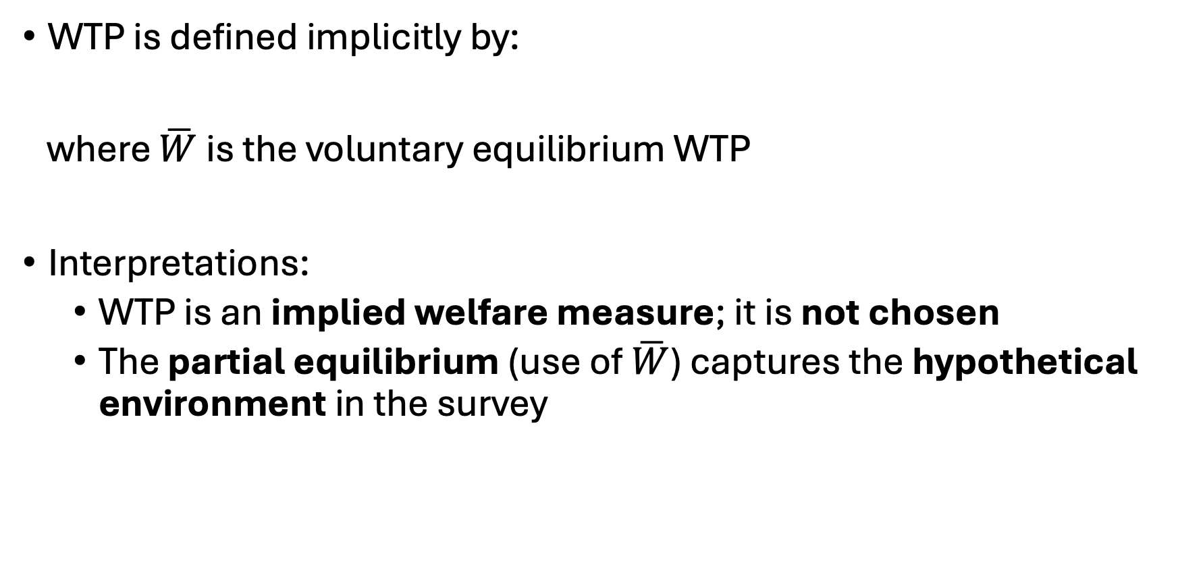
1. WTP as Compensating Variation
WTP is defined implicitly by:
where $\overline{W}$ is the voluntary equilibrium WTP
Interpretations:
WTP is an implied welfare measure; it is not chosen
The partial equilibrium (use of $\overline{W}$) captures the hypothetical environment in the survey
$${\{u}_{i}\left(c−W^{CV}\right)+E_{i,1}(\overline{W})+M_{i,1}(\overline{W})\}={\{u}_{i}\left(c\right)+E_{i,0}(\overline{W})+M_{i,0}(\overline{W})\},$$
Discusses at the end

Slide 7
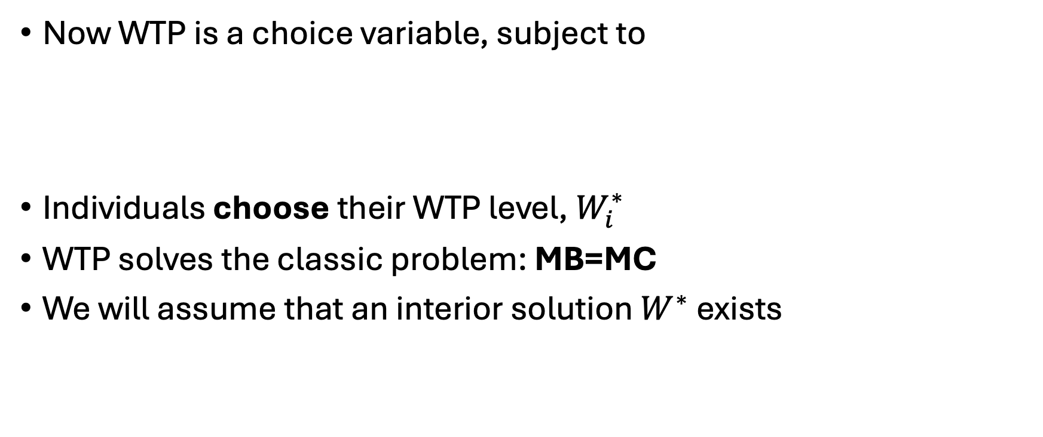
2. WTP as Optimisation
Now WTP is a choice variable, subject to
Individuals choose their WTP level, $W_{i}^{∗}$
WTP solves the classic problem: MB=MC
We will assume that an interior solution $W^{∗}$ exists
$$W_{i}^{∗}∈arg{\max_{W_{i}≥0}{\{u\left(c−W_{i}\right)+E_{i}\left(W_{i}\right)+M_{i}\left(W_{i}\right)}{\}}}$$

Slide 8
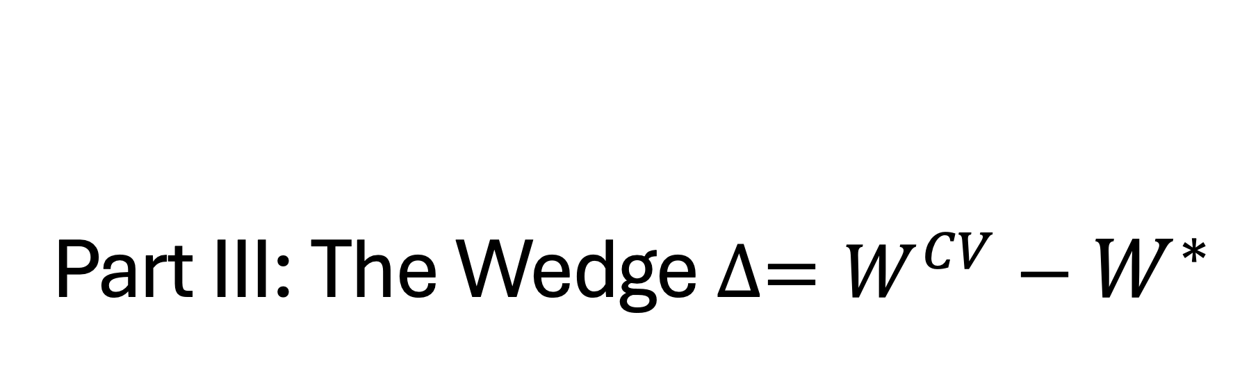
Part III: The Wedge $∆=W^{CV}−W^{∗}$

Slide 9

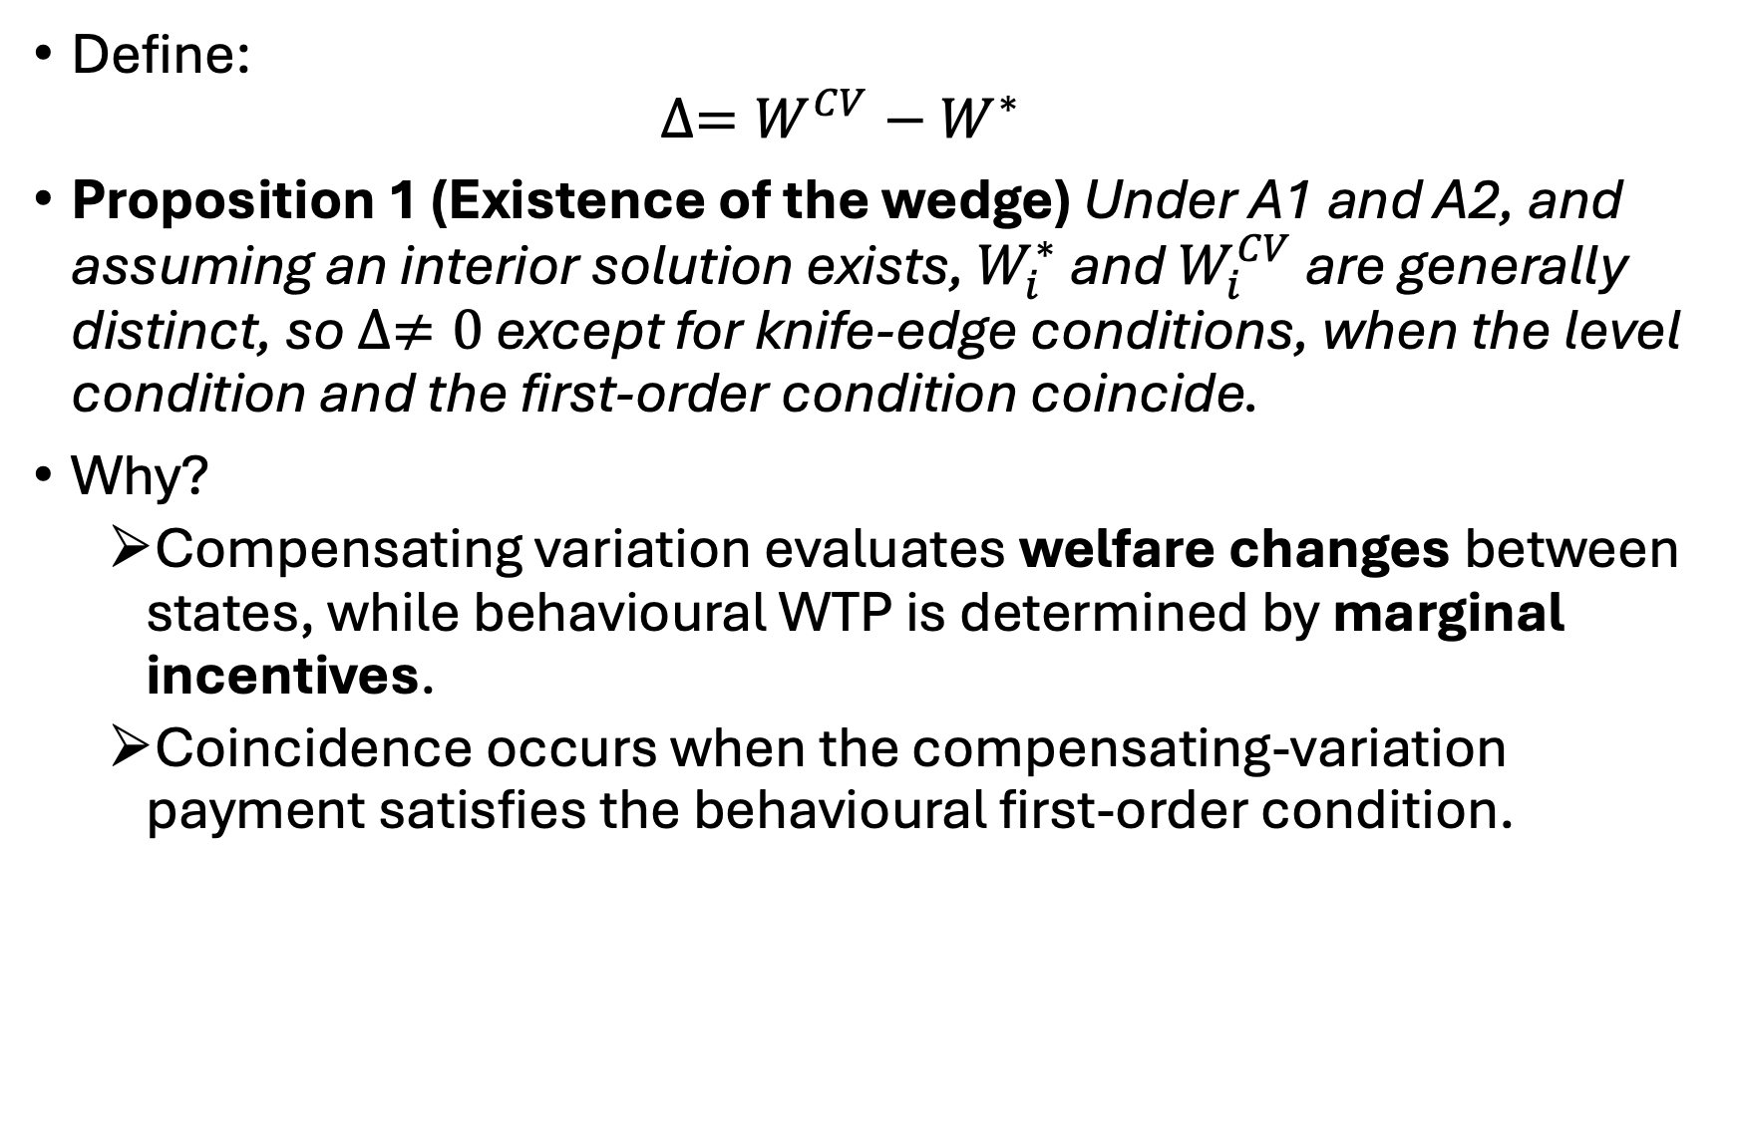
The Wedge $∆$
Define:
$$∆=W^{CV}−W^{∗}$$
Proposition 1 (Existence of the wedge) Under A1 and A2, and assuming an interior solution exists, $W_{i}^{∗}$ and $W_{i}^{CV}$ are generally distinct, so $∆≠0$ except for knife-edge conditions, when the level condition and the first-order condition coincide.
Why?
Compensating variation evaluates welfare changes between states, while behavioural WTP is determined by marginal incentives.
Coincidence occurs when the compensating-variation payment satisfies the behavioural first-order condition.

Slide 10
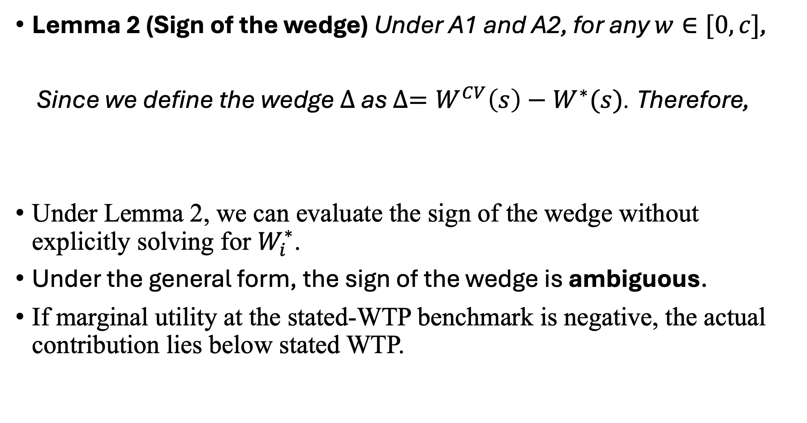
Sign and Mechanism
Lemma 2 (Sign of the wedge) Under A1 and A2, for any $w∈[0,c]$,
Since we define the wedge $∆$as $∆=W^{CV}\left(s\right)−W^{∗}(s)$. Therefore,
Under Lemma 2, we can evaluate the sign of the wedge without explicitly solving for $W_{i}^{∗}$.
Under the general form, the sign of the wedge is ambiguous.
If marginal utility at the stated-WTP benchmark is negative, the actual contribution lies below stated WTP.
$$w≶W_{i}^{∗}\left(s\right) ⟺{ U}_{W}\left(w;s\right)≷0.$$
$$∆ ≶0⟺U_{W}\left(W^{CV}(s);s\right)≷0.$$

Slide 11
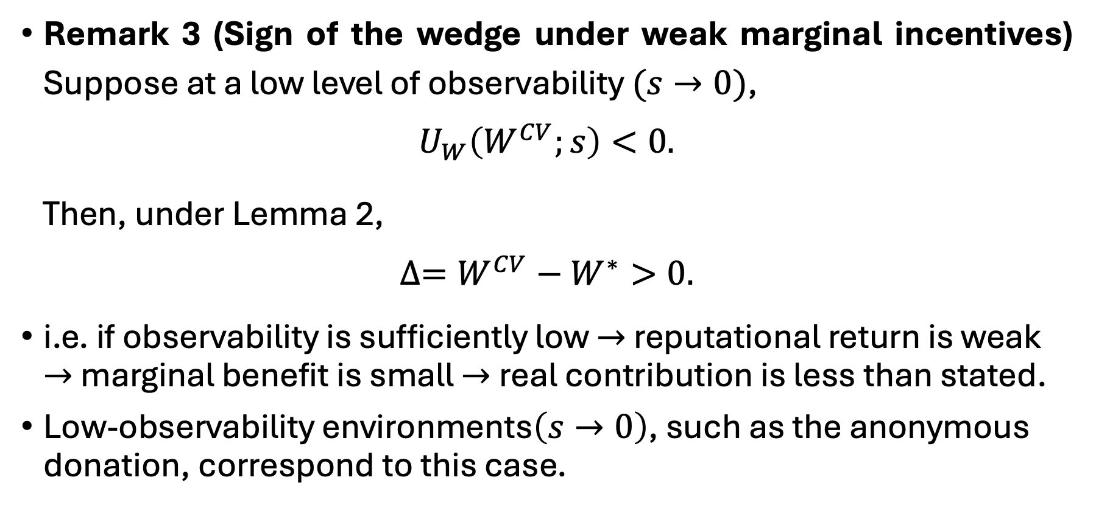
Real-World Implication
Remark 3 (Sign of the wedge under weak marginal incentives) Suppose at a low level of observability$(s→0)$,
$$U_{W}\left(W^{CV};s\right)<0.$$
Then, under Lemma 2,
$$∆=W^{CV}−W^{∗}>0.$$
i.e. if observability is sufficiently low $→$ reputational return is weak $→$ marginal benefit is small $→$real contribution is less than stated.
Low-observability environments$\left(s→0\right)$, such as the anonymous donation, correspond to this case.

Slide 12
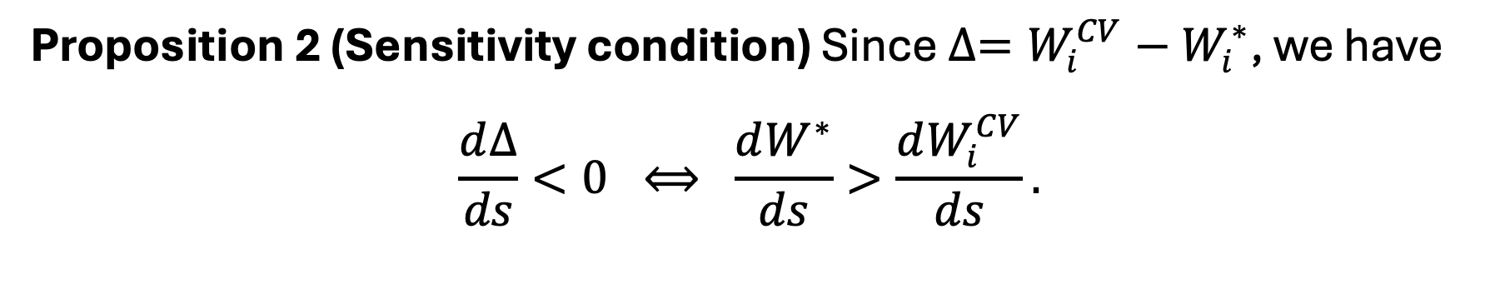
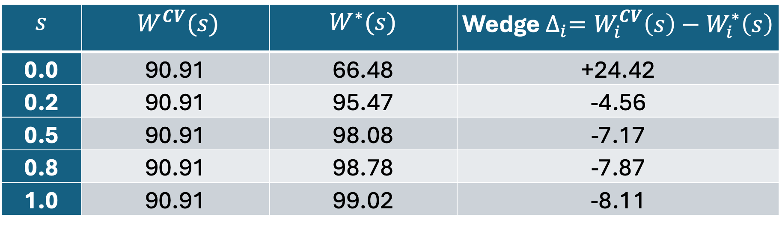
Observability and a Numerical Illustration
Proposition 2 (Sensitivity condition) Since $∆=W_{i}^{CV}−W_{i}^{∗}$, we have
$$\frac{d∆}{ds}<0 ⟺ \frac{dW^{∗}}{ds}>\frac{dW_{i}^{CV}}{ds}.$$
$$s$$ | $$W^{CV}(s)$$ | $$W^{∗}(s)$$ | Wedge $∆_{i}=W_{i}^{CV}\left(s\right)−W_{i}^{∗}\left(s\right)$
0.0 | 90.91 | 66.48 | +24.42
0.2 | 90.91 | 95.47 | -4.56
0.5 | 90.91 | 98.08 | -7.17
0.8 | 90.91 | 98.78 | -7.87
1.0 | 90.91 | 99.02 | -8.11
Table 1: The Parametric Example Results

Slide 13
Part IV: Summary & Discussion

Slide 14
Summary & Implication
WTP is not one concept, but
Under CV, it’s the welfare value from changing states.
Under optimisation, it’s the behavioural contribution chosen under marginal incentives.
They are conceptually distinct objects.
Policies that enhance observability—such as public recognition or visible commitments—can potentially reduce the gap between stated WTP and actual behaviour.
Observability is one mechanism within our model construction, not the only factor that could shift the wedge.

Slide 15
Literature, Extensions & Discussions
CV-WTP is a welfare-level valuation object (Hicks, 1939), and stated-preference design has been used to recover this welfare (Carson and Groves, 2007; etc.).
Survey answers should be expected to differ from behaviour.
Dynamic settings may depend on perceived equilibrium (Zhao and Kling, 2004), motivating the extension of dynamic learning/equilibrium.
This paper can be extended to provide a theoretical foundation for cheap-talk design in contingent valuation.
Standard cheap-talk is usually viewed as reducing hypothetical bias (Cummings and Taylor, 1999).
My interpretation: cheap talk may alter the relationship between stated valuation and behavioural incentives.

Slide 16
More broadly…
The paper reflects a wider theoretical interest:
Behavioural tools (such as cheap talk) are often treated as practical fixes
Yet some remain theoretically under-modelled.
This paper starts from a behavioural puzzle and asks what economic object was being changed, rather than following the ‘path of least theory’ (Spiegler, 2024).
Theory asks: what object changes, through which incentive channel, and why does behaviour change?
Economics is not only about measuring effects but also about explaining mechanisms.

